Slide 1

5G NETWORK SLICING
Name | USN | Roll No
PRATEEK PATIL | 01FE19BEC058 | 216
ADNAN LADJI | 01FE19BEC252 | 511
YASH MAHALE | 01FE19BEC265 | 522
SURAJ BADDI | 01FE19BEC268 | 525
MENTOR - Prof. Shamshuddin K, Naveen K N

Slide 2

Problem Statement
“Simulate and Analyze 5G Network Slicing using open-source software for different use-cases.”

Slide 3
Objectives
To Understand the concept of 5G and Network Slicing.
To Explore various simulation tools available for Network Slicing.
To simulate 3 use-cases of 5G Network slicing.
To analyze the results obtained from the simulation.

Slide 4
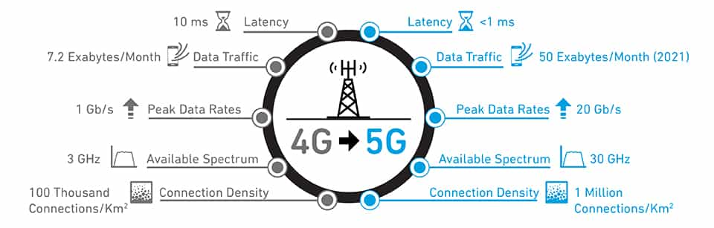
4G vs 5G
4G was the preset standard for mobile network connections.
5G, the latest evolution, is a network developed for the current digital landscape to connect customers, companies, machines, and devices

Slide 5
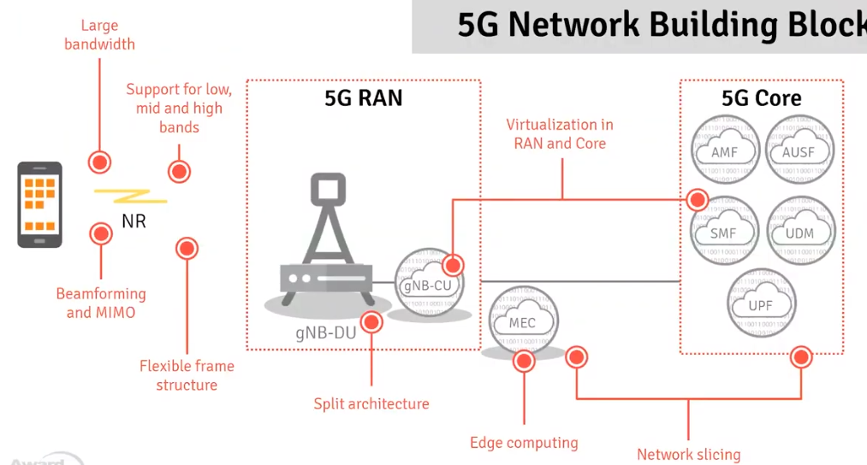
5G Architecture

Slide 6
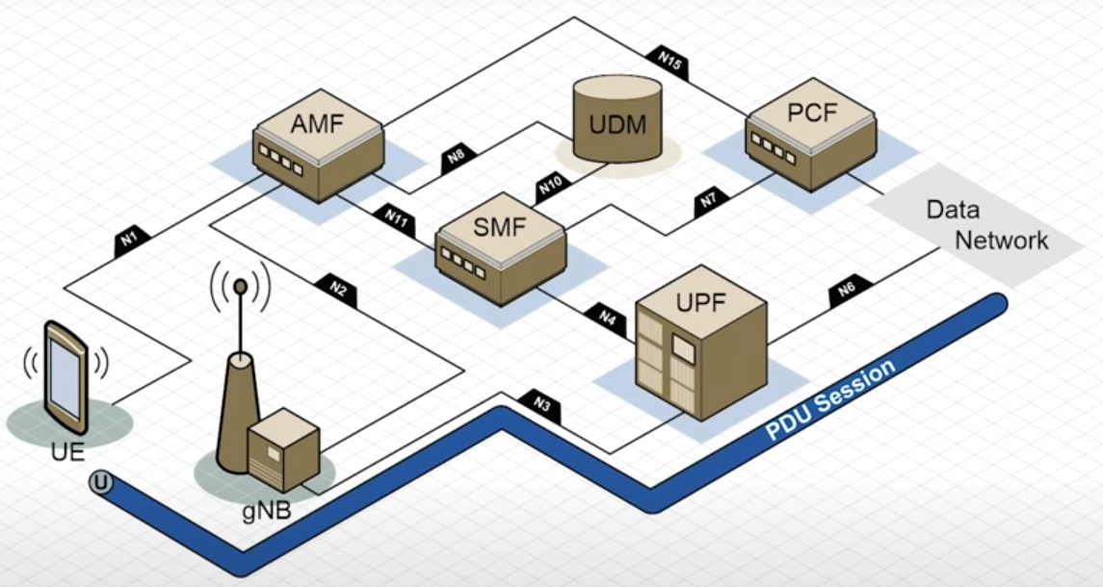
5G Architecture
AMF (Access & Mobility Management Function) :
Authenticate connection and receive a session and connection-related information of UE.
UDM (Unified Data Management): Managing and generation of user credentials.
SMF (Session Management Function) : IP allocation and Policy enforcement.
UPF (User Plane Function):
Forwards traffic between RAN and the Internet
Responsible for policy enforcement, lawful intercept, traffic usage reporting, and QoS policing.
PCF (Policy Control Function):
Manages the policy rules that other CP functions then enforce
gNB: 5G base station

Slide 7
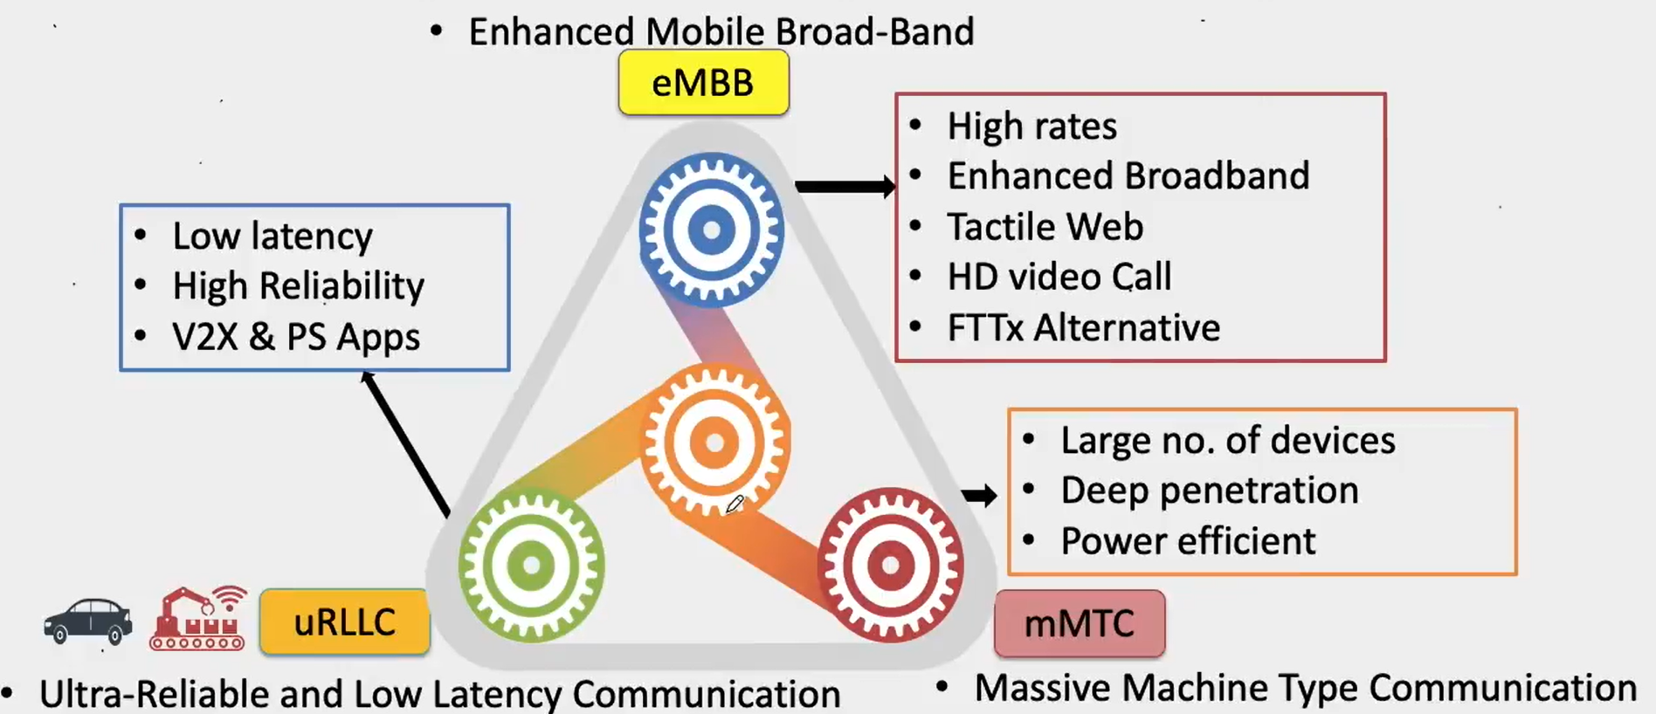
Network Slicing
5G network slicing is the use of network virtualization to divide single network connections into multiple distinct virtual connections that provide different amounts of resources to a different type of traffic.

Slide 8
Why Slicing is Required?
A single network can be used to offer various services based on the requirements of the user and various use cases
Network operators can allocate the right number of required resources as per network slice. Hence, it helps in the effective and efficient utilization of resources. For example, one network slice can be designed to deliver low latency, while the other network slice can be configured to deliver a high data rate.
It vastly improves operational efficiency and time to market for the delivery of 5G network services. Based on the requirements if slices are already configured then the deployment time decreases.

Slide 9
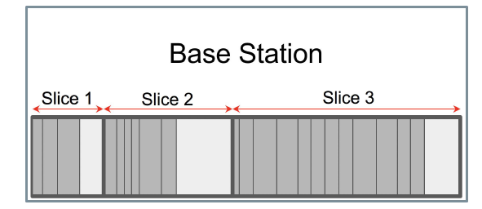
How a Slice is Created?
A base station has slices in it tailored for different needs:
• Guaranteed bandwidth for each customer
• Max. bandwidth limit for each customer
• Allocated throughput for a slice
• QoS class
• Delay tolerance
Frequency (Hz)
Each Slice created has a QoS defined in the 3GPP standard, which is configured using the Bandwidth requirement for each slice.
eMBB
uRLLC
Slices | QoS Class
uRLLC | 1
mMTC | 2
eMBB | 5

Slide 10
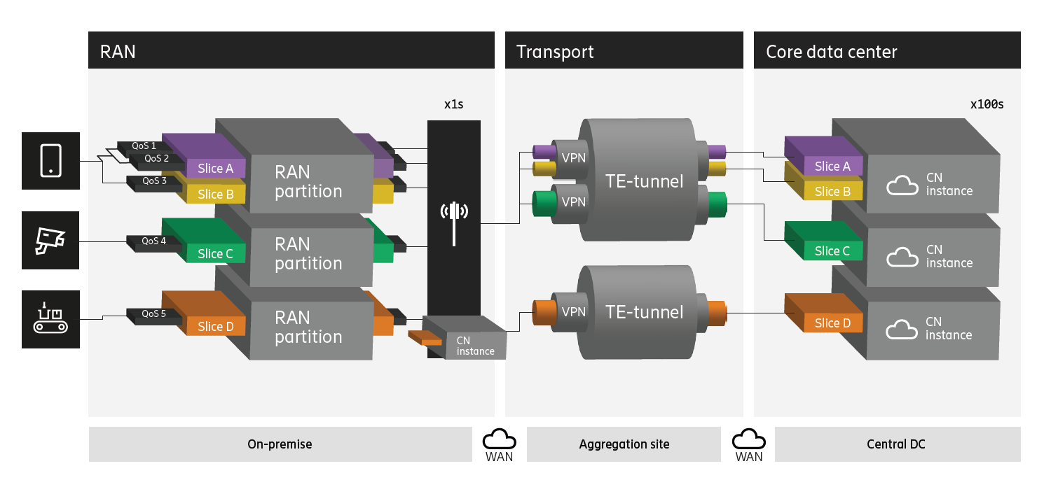
End-To-End Slice

Slide 11
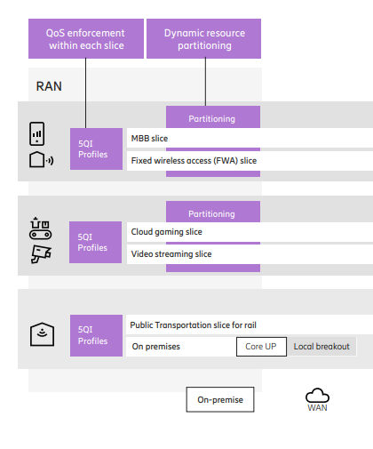
RAN Slice
The first is to understand resource utilization and service performance to optimize the RAN slice configuration and operation.
The other is to provide service performance indicators, traffic load, and radio conditions per slice to gauge SLA conformity for the respective end-to-end network slices.
When a dedicated radio bearer (DRB) is created, the RAN will assign it to a specific network slice as per configuration instructions received from the 5G core.

Slide 12
Softwares Available
Open Source software available for 5G implementation
NS3 – Network Simulation 3
srsRAN
MatLab
Slicesim
Slicesim is a better simulation tool for the analysis of slice parameters. Hence we have chosen Slicesim for our project.
Flexibility in the deployment of the number of Base stations and clients.
User-friendly interface, uses python scripts for the creation of slices.
Generation of graphs for better visualization.

Slide 13
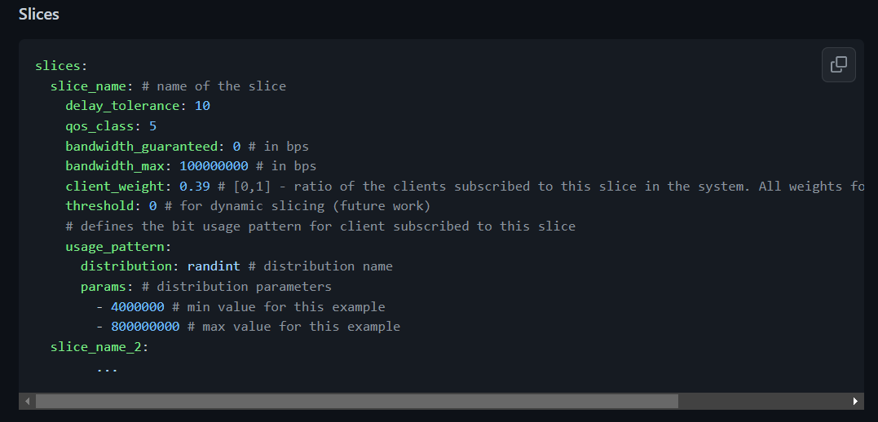
Slicesim - Slices

Slide 14
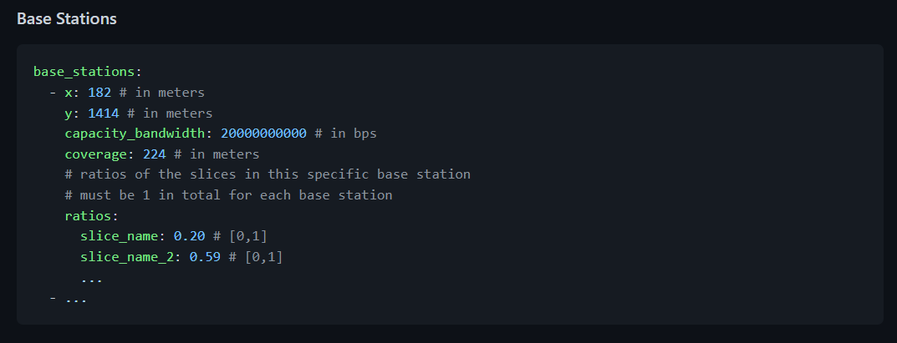
Slicesim – Base stations

Slide 15
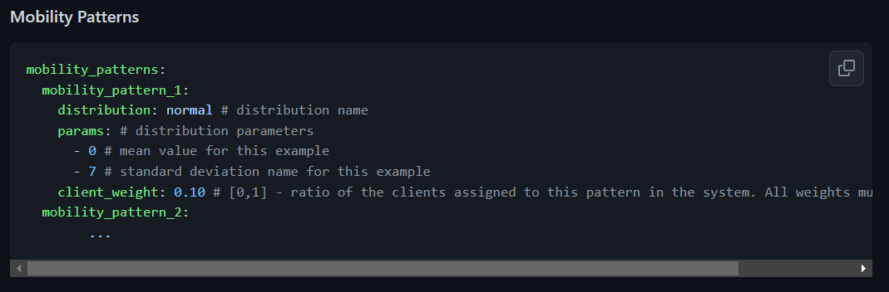
Mobility Patterns
Mobility Patterns
Cars, Stationary, Walk, etc.

Slide 16
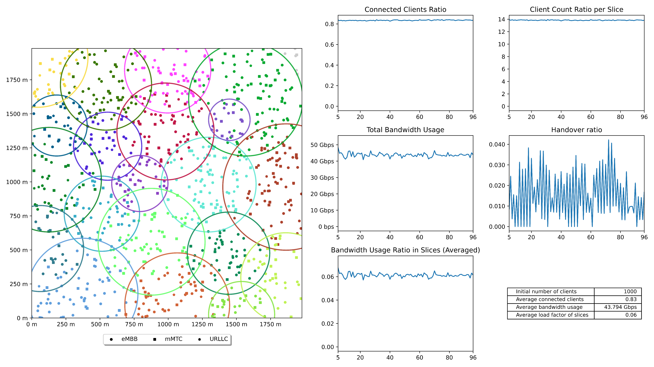
Simulation Output – 1k clients
Simulation Area

Slide 17
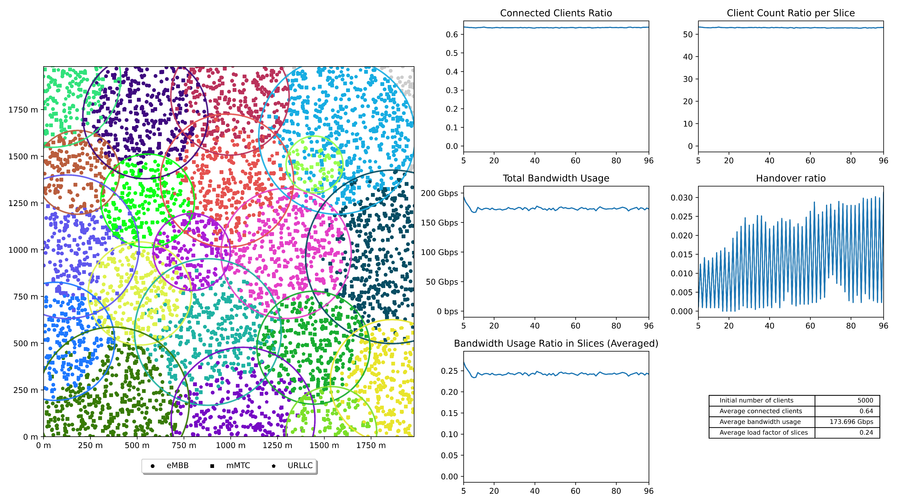
Simulation Output – 5k clients
Simulation Area

Slide 18
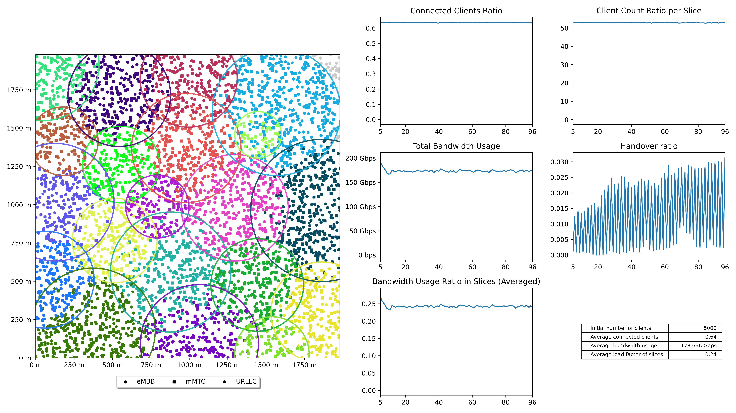
Conclusion
1k Clients
5k Clients
From the above output, we can see that
As the no of clients increases, then average bandwidth usage increases as more clients are using different services with more bandwidth requirements.
As the no of clients increases, the average load factor of slices also proportionally increases.
As the no of clients increases, the average number of connected clients decreases because each base station has a limited bandwidth allocated, exhaustion of the bandwidth makes no further clients connect to the base station.

Slide 19
Thank you

